Slide 1
Text Mining
L03. Vector semantics

Slide 2
Today’s lecture
Quiz about week 2
Preliminaries
distributional hypothesis
vector space model
Topic modelling
LDA
Word embeddings
word2vec

Slide 3
Quiz about week 2
What is the main limitation of ASCII?
It can only encode letters that occur in the American alphabet
It is not compatible with other encodings
It compresses text files and causes quality loss

Slide 4
Quiz about week 2
What kind of strings does this regular expression match: /<[^>]+>/
Smaller than / larger than
Any HTML/XML tag
Any URL

Slide 5
Quiz about week 2
Do you think it is possible to make a language independent lemmatizer?
Yes, because a lemmatizer uses a dictionary
Yes, because a lemmatizer uses patterns
No, because a lemmatizer uses a dictionary
No, because a lemmatizer uses patterns

Slide 6
Quiz about week 2
What is the Levenshtein distance between ‘sheep’ and ‘ship’?
1
2
3
4

Slide 7
Quiz about week 2
Did you work on the exercise of week 2? (pre-processing with Spacy)
No
Yes, I started
Yes, I completed at least half of it
Yes, I completed it

Slide 8
Exercise week 2 – text processing
https://course.spacy.io/en/chapter1
Please contact the TAs if you encounter any difficulties
(this is also a way to refresh your Python knowledge and get used to NLP principles)

Slide 9
Vector semantics Preliminaries

Slide 10
Where to start
Linguistics: Distributional hypothesis
Information Retrieval: Vector Space Model (VSM)

Slide 11
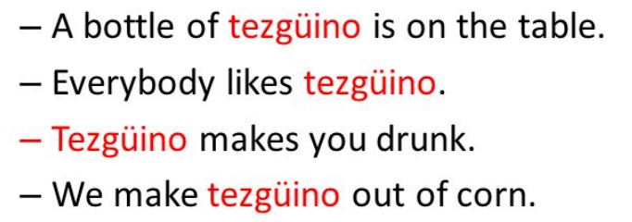
Distributional hypothesis
Harris, Z. (1954). “Distributional structure”. Word. 10 (23): 146–162
The context of a word defines its meaning
Words that occur in similar contexts tend to be similar

Slide 12
Vector Space Model
Traditional Vector Space Model (Information Retrieval):
documents and queries represented in a vector space
where the dimensions are the words
Document 1 (6,3)
(6,3)

Slide 13
Vector Space Model
Two problems with the vector space model:
synonymy: many ways to refer to the same object, e.g. bicycle and bike
polysemy: many words have more than one distinct meaning, e.g. bank, bass, chips

Slide 14
Alternative semantics
Alternative: do not represent documents by words, but by
topics → topic modelling
concepts → word embeddings

Slide 15
Topic modelling

Slide 16
Topic modelling
Assumptions
each document consists of a mixture of topics, and
each topic consists of a mixture of words
“Topic modeling provides methods for automatically organizing, understanding, searching, and summarizing large electronic archives” (Blei, 2009)
Often used for corpus exploration: what topics are discussed and how frequent are they?

Slide 17
Topic modelling
Topic modelling is an unsupervised technique
Topic labels are not given
The number of topics needs to be pre-specified
Think about it as clustering

Slide 18
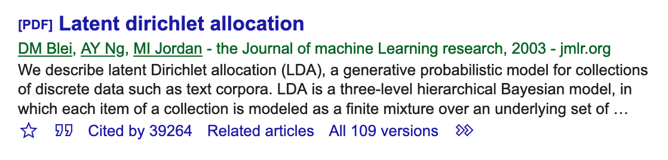
Latent Dirichlet Allocation (LDA)
Most used topic modelling technique
Popular in applied Text Mining in many domains
(especially the social sciences)

Slide 19
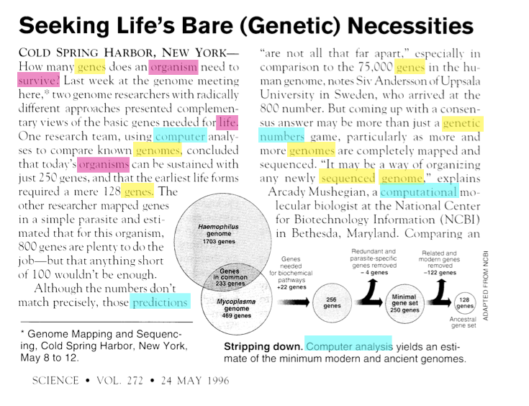
Intuition behind LDA
One document exhibits multiple topics
Words are more related to one topic than to another
Notes:
Blue: Computer analysis
Red: Evolutionary biology
Yellow: Genomics

Slide 20
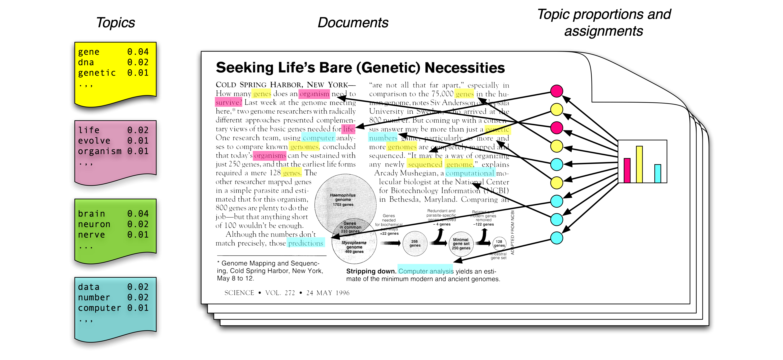
Generative model
Each document is a mixture of corpus-wide topics
Each word is drawn from one of those topics
Notes:
https://en.wikipedia.org/wiki/Generative_model
Topic = distribution over fixed vocabulary.
Every topic contains a probability for every word in the vocabulary
Each document is a distribution over topics.

Slide 21
Generative model
Topic = probability distribution over fixed vocabulary. Every topic contains a probability for every word in the vocabulary
Each document is a distribution over topics
Dirichlet distribution: continuous multivariate probability distribution
The prior set on the Dirichlet distribution is a sparse Assumption: each document covers only a small set of topics and each topic uses only a small set of words frequently
Notes:
Dirichlet distribution: family of continuous multivariate probability distributions parameterized by a vector α of positive reals
(multivariate because there are multiple variables with a probability distribition. continuous: because each variable has a real value as outcome)
in LDA the topic distribution is assumed to have a sparse Dirichlet prior. The sparse Dirichlet priors encode the intuition that documents cover only a small set of topics and that topics use only a small set of words frequently. In practice, this results in a better disambiguation of words and a more precise assignment of documents to topics.

Slide 22
Generative model
We generate a document as a bag of words:
We draw a topic from the distribitution (e.g. yellow), lookup the yellow distribution, and draw a word from the yellow distribution. Etc.
The order of words doesn’t matter; the words are drawn independently of each other
We only observe the words in the documents. The topics are latent.
Notes:
in LDA the topic distribution is assumed to have a sparse Dirichlet prior. The sparse Dirichlet priors encode the intuition that documents cover only a small set of topics and that topics use only a small set of words frequently. In practice, this results in a better disambiguation of words and a more precise assignment of documents to topics.

Slide 24
Learn the distributions
What are the topics, what are the distributions over terms?
For each document, what is the distribution over topics?
Notes:
rom a collection of documents, infer •Per-word topic assignment zd ,n •Per-document topic proportions θd •Per-corpus topic distributions βk

Slide 25
Notes:
Beta_k are the topics themselves. Each Beta is a distribution over terms and we have K of them (K might be 100). Beta comes from a dirichlet distribution.
D is the document plate (corpus). Theta_d = topic proportions for the document. One for each document = D plate
N plate is for each word. Zd,n is a number from 1 to k; the topic assignment (coloured marble). Zd,n is drawn from theta_d. There is a coloured marble for every word. Wd,n depends on Zd,n and Betas (because the probability of drawing a word depends on both the probability of the word in the topic (Beta_k) and the probability of the topic in the document (Theta_d). Theta_d is a K-dimensional vector of probabilities, which must sum to 1. Wd,n is the nth word in the d’th document. It is the only observed random variable. Probability of Wd,n from the topic that was drawn for Zd,n
Alpha is your initial belief about this distribution, and is the parameter of the prior distribution. Usually this is chosen in such a way that will have a conjugate prior (so the distribution of the posterior is the same with the distribution of the prior) and often to encode some knowledge if you have one or to have maximum entropy if you know nothing.

Slide 26
Learn the topics from the data
Goal: to learn β (the topic models) and 𝜃
We only observe the words W
Start with random probability distributions of words in topics and of topics in documents
Update the probability distributions while observing the words in the documents
Until β converges, or the maximum number of epochs has been reached
Notes:
https://algobeans.com/2015/06/21/laymans-explanation-of-topic-modeling-with-lda-2/

Slide 27
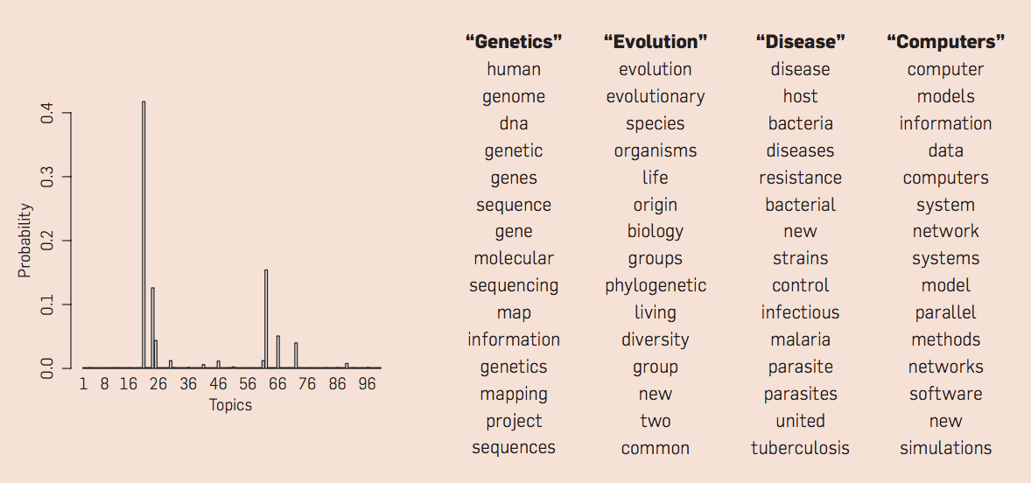
100-topic LDA model of 17,000 Science articles
https://m-cacm.acm.org/magazines/2012/4/147361-probabilistic-topic-models/fulltext?mobile=true

Slide 28
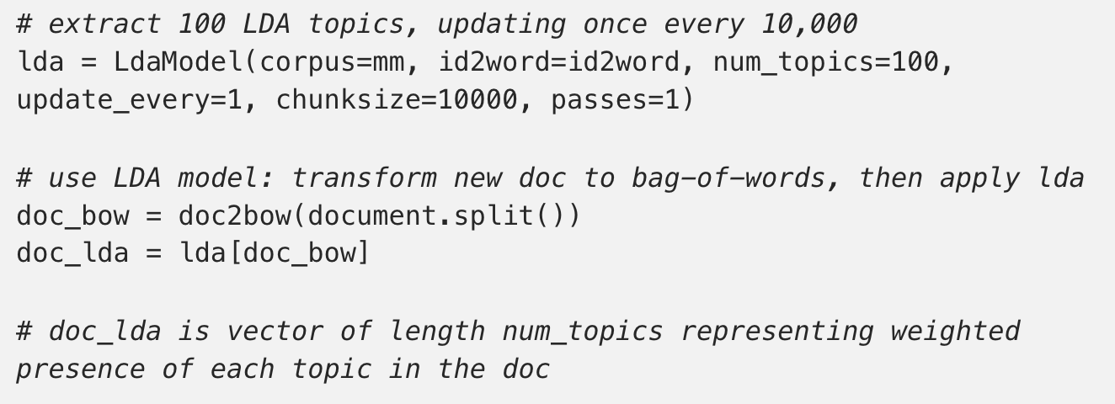
Latent Dirichlet Allocation (LDA)
Popular implementation in gensim
https://radimrehurek.com/gensim/models/ldamodel.html

Slide 29
Challenges with LDA
Choose the number of topics
Random initiation of the clustering → the outcome is non-deterministic
Needs a large dataset to give stable results
Interpreting the output: what do the topics mean?

Slide 30
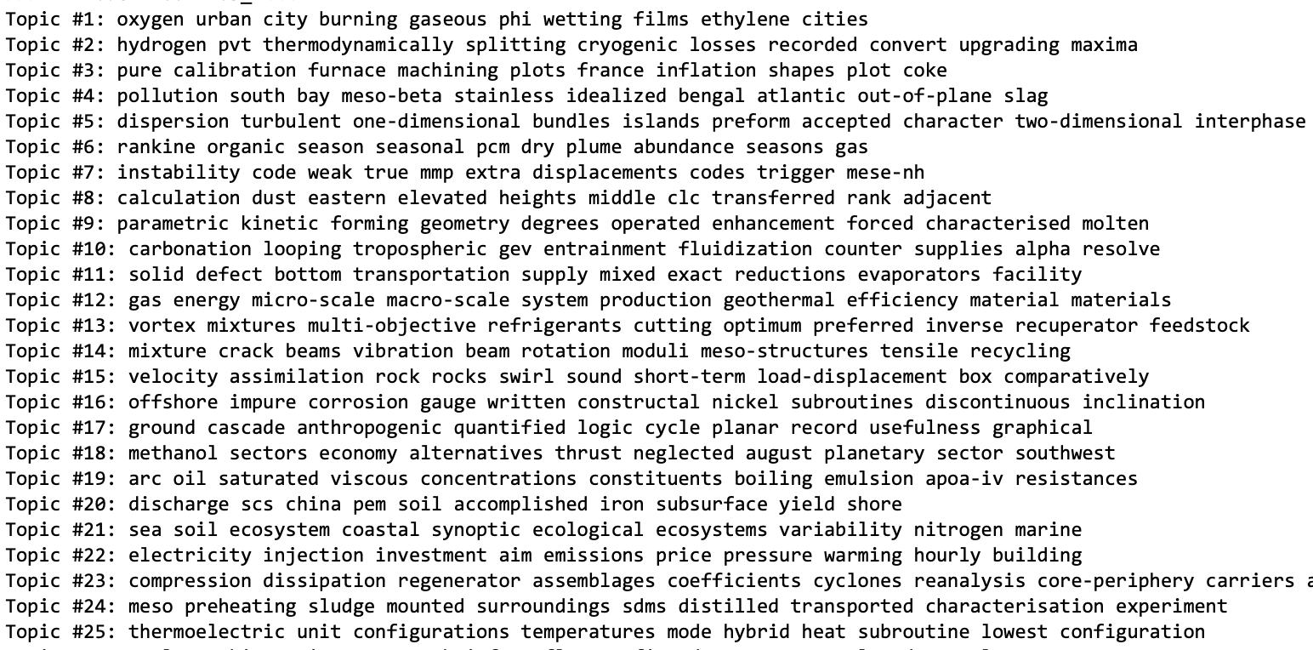
Raw Example output

Slide 31
Questions to discuss
Topic modelling is often used as method for data exploration (followed by expert interpretation). How could you use the output of LDA for text classification? Think about the case of classifying health-related newspaper articles.
How would you evaluate an LDA model?

Slide 32
Evaluation of topic modelling
Use LDA output for classification?
Represent document as ‘bag of topics’ (the topic ids)
How to evaluate?
Topic coherence, also used for optimizing the number of topics
Human evaluation:
Word intrusion: given these 5 high-probability topic words + 1 random word, can you find the intruder?
O’callaghan, D., Greene, D., Carthy, J., & Cunningham, P. (2015). An analysis of the coherence of descriptors in topic modeling. Expert Systems with Applications, 42(13), 5645-5657.

Slide 33
More information
Tutorial (optional): https://www.machinelearningplus.com/nlp/topic-modeling-gensim-python/
LDA lecture: http://videolectures.net/mlss09uk_blei_tm/
Alternative to LDA: Non-negative matrix factorization (NMF) https://towardsdatascience.com/topic-modeling-articles-with-nmf-8c6b2a227a45

Slide 34
Word embeddings

Slide 35
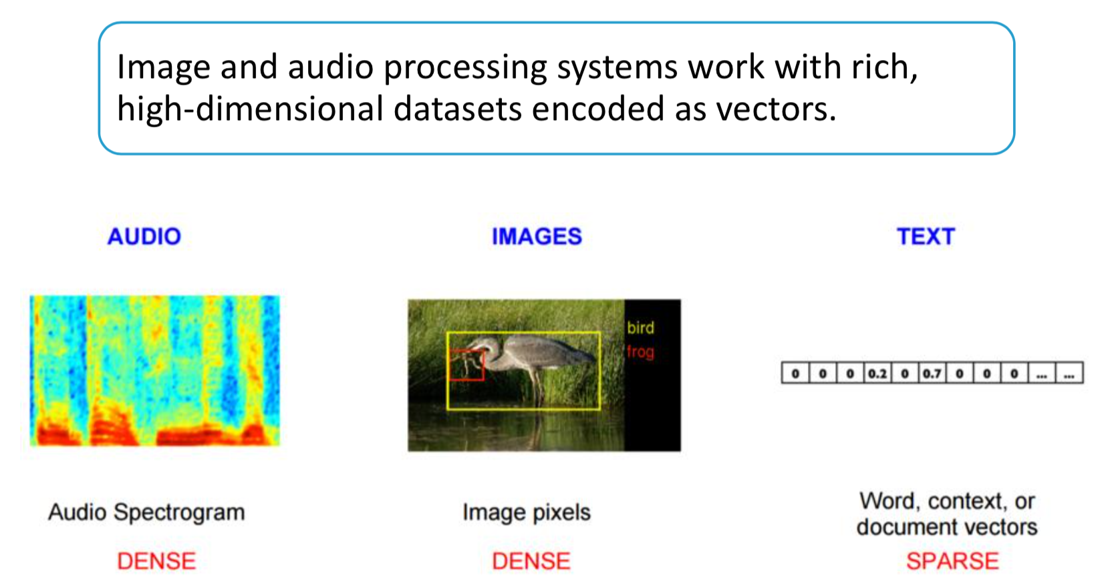
Vector Space Model

Slide 36
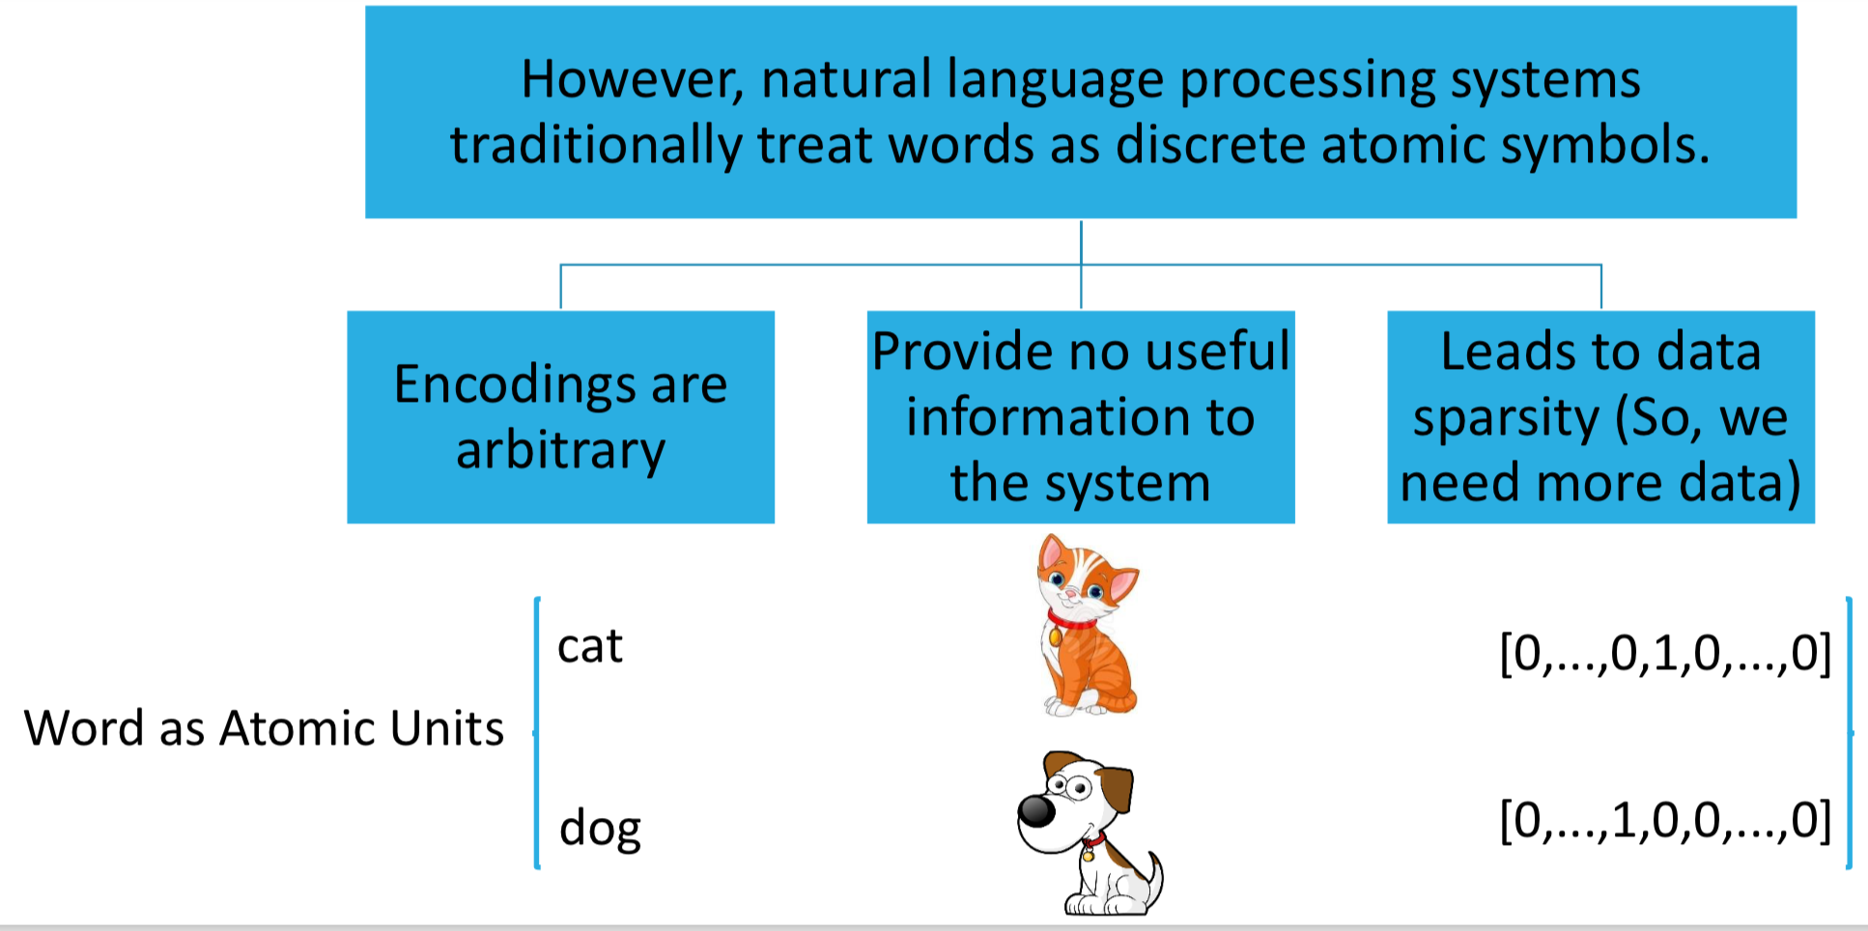
Vector Space Model
Notes:
One-hot encoding

Slide 37
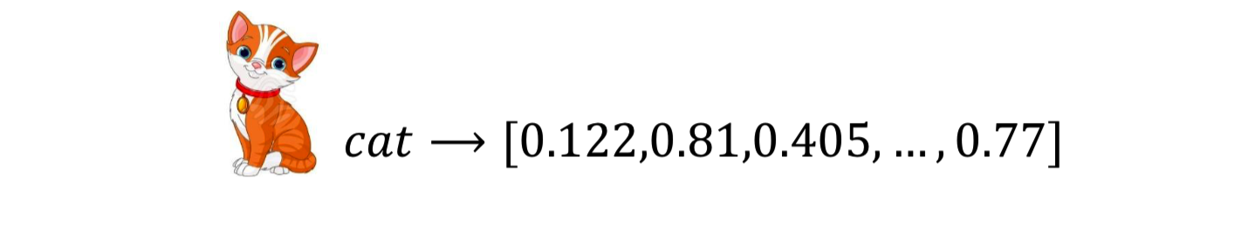
Word embeddings
Word embeddings are dense representations of words

Slide 38
Word embeddings
Word embeddings models represent (embed) words in a continuous vector space
The vector space is relatively low-dimensional (100 – 320 dimensions instead of 10,000s)
Semantically and syntactically similar words are mapped to nearby points (Distributional Hypothesis)

Slide 39
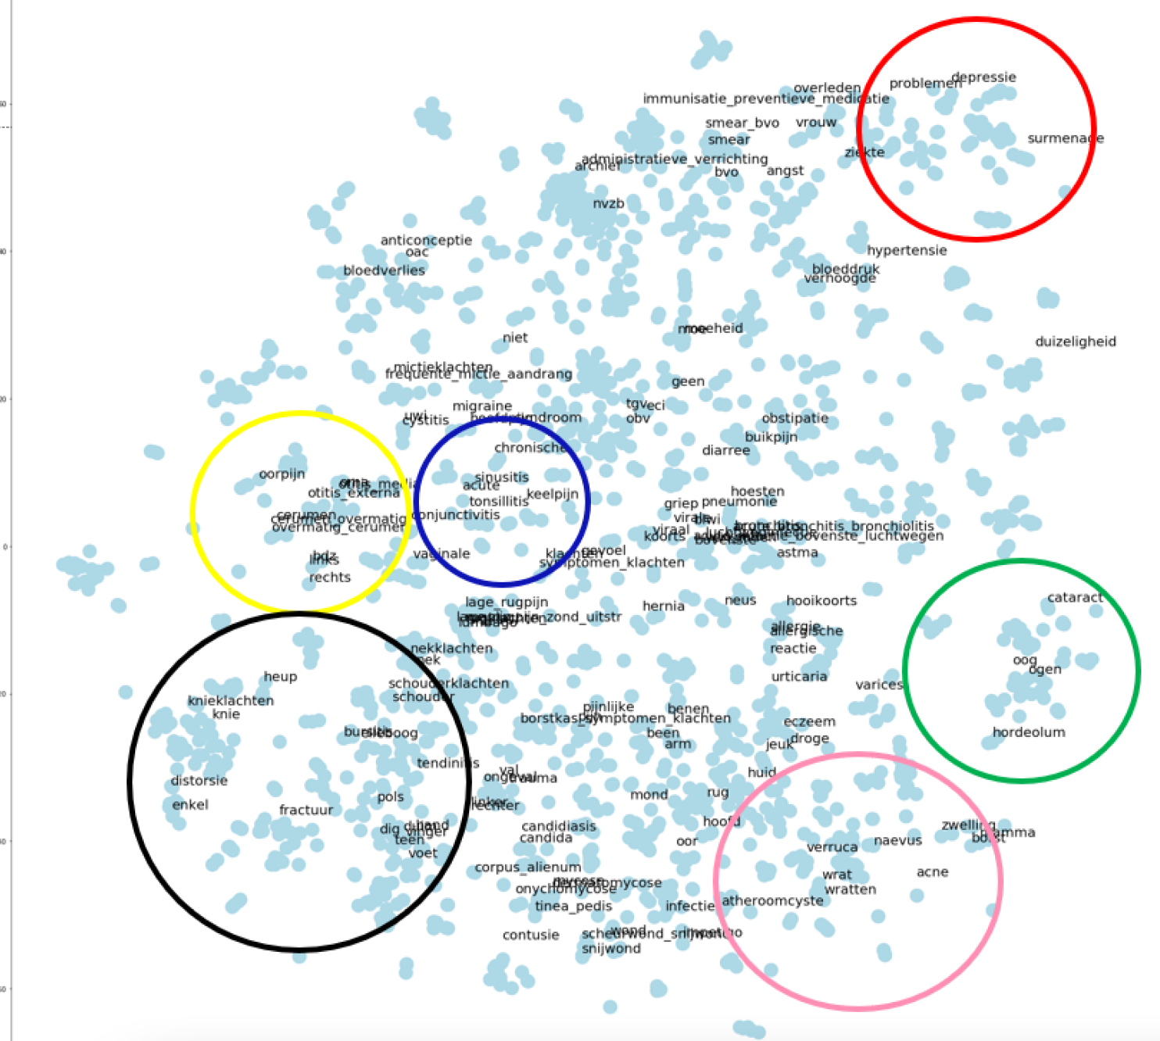
PCA projection of 320-dimensional vector space
Notes:
Word embedding model after dimensionality reduction. The 150 most frequent words are annotated and some medical domains are indicated using ellipses based on expert knowledge. Red: psychosocial problems, yellow: ear-related problems, blue: upper respiratory tract problems, black: musculoskeletal problems, pink: dermatological problems, green: eye-related problems

Slide 40
Word2vec
J&M, section 6.8

Slide 41
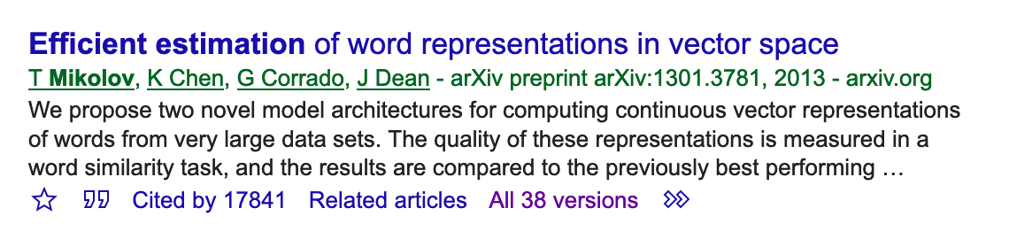
What is word2vec?
Word2vec is a particularly computationally-efficient predictive model for learning word embeddings from raw text

Slide 42
What is word2vec?
Intuition:
Train a neural classifier on a binary prediction task (on a text without labels!): “Is word w likely to show up near the word bicycle?”
We don’t actually care about this prediction task; instead we’ll take the learned classifier weights as the word embeddings

Slide 43
Where does it come from
Neural network language model (NNLM) (Bengio et al., 2003)
Mikolov proposed to learn word vectors using a neural network with a single hidden layer (Mikolov et al 2013): word2vec
Many neural architectures and models have been proposed for computing word vectors
GloVe (2014) - Global Vectors for Word Representation
FastText (2017) - Enriching Word Vectors with Subword Information
ELMo (2018) - Deep contextualized word representations
BERT (2019) - Bidirectional Encoder Representations from Transformers

Slide 44
Word2vec
Starting point: large collection (e.g. 10 Million words)
First step: extract the vocabulary (e.g. 10,000 terms)
Goal: to represent each of these 10,000 terms as a dense, lower-dimensional vector (typically 100-400 dimensions)

Slide 45
Training Word2vec
Training method: skip-gram with negative sampling
Training task is simple: binary classification of words in the text
Treat the target word and a neighboring context word as positive examples
Randomly sample other words in the lexicon to get negative samples
Train a logistic regression classifier to distinguish those two cases
The learned weights are the embeddings
It is a supervised learning problem on un-labeled data (running text). This is called self-supervision

Slide 46
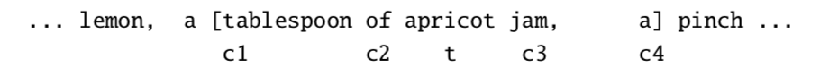
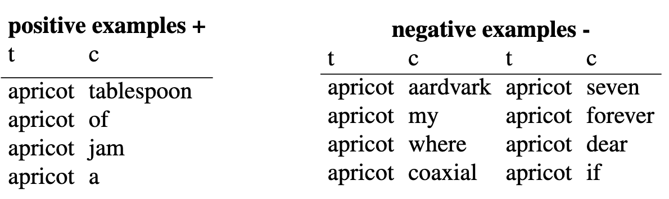
Training word2vec
This example has a target word t (apricot), and 4 context words in the L = ±2 window, resulting in 4 positive training instances
Negative examples are artificially generated:

Slide 47
Training Word2vec
The weights on the nodes in the hidden layer get random initializations
The goal of the learning algorithm is to adjust those embeddings to
maximize the similarity of the target word, context word pairs (w,c_{pos}) drawn from the positive examples
minimize the similarity of the (w,c_{neg}) pairs from the negative examples
The weights get updated while the model processes the collection
in order to maximize the dot product of the word with the actual context words, and minimize the dot products of the word with the k negative sampled non-neighbor words (Gradient descent optimization)

Slide 48
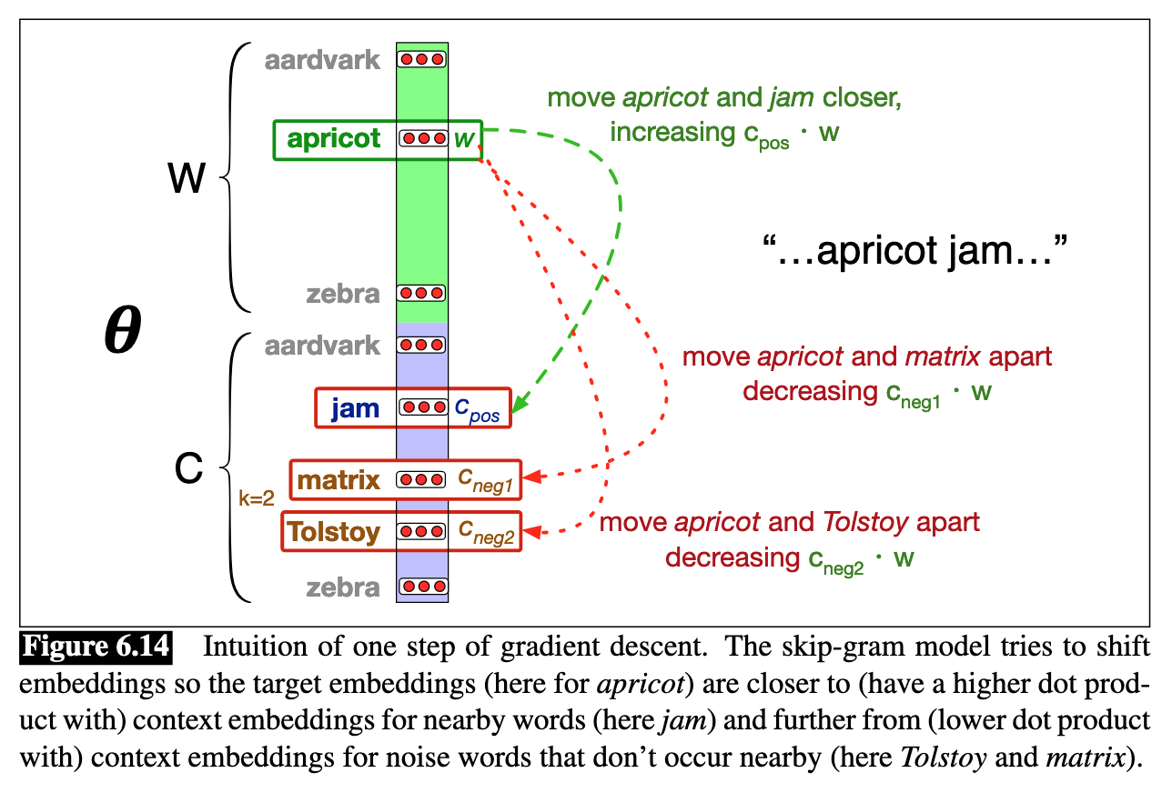
Training Word2vec
Notes:
The classifier is a neural network with one hidden layer
Logistic sigmoid functions are used as activation functions in the hidden layer. The regression weights are the embeddings

Slide 49
Training Word2vec
Summary:
Move through the training corpus with a sliding window. Each word + context is a classification problem
The outcome of the classification determines whether we adjust the current word vector. Gradually, vectors converge to (hopefully) optimal values
It is important that the context classification here is not an aim in itself: it is just a proxy to learn vector representations good for other tasks

Slide 50
Advantages of word2vec
It scales
Train on billion word corpora
In limited time
Possibility of parallel training
Pre-trained word embeddings trained by one can be used by others
For entirely different tasks
Incremental training
Train on one piece of data, save results, continue training later on
There are Python modules for it:
Gensim word2vec

Slide 51
Do it yourself
Implementation in Python package gensim
import gensim
model = gensim.models.Word2Vec(sentences, size=100, window=5, min_count=5, workers=4)
size: the dimensionality of the feature vectors (common: 200 or 320)
window: the maximum distance between the current and predicted word within a sentence
min_count: minimum number of occurrences of a word in the corpus to be included in the model
workers: for parallellization with multicore machines

Slide 52
Do it yourself
model.most_similar(‘apple’)
[(’banana’, 0.8571481704711914), ...]
model.doesnt_match("breakfast cereal dinner lunch".split())
‘cereal’
model.similarity(‘woman’, ‘man’)
0.73723527

Slide 53
What can you do with it?
Mining knowledge about natural language
Improve NLP applications
Improve Text Mining applications

Slide 54
What can you do with it?
Mining knowledge about natural language
Learning semantic and semantic relations

Slide 55
What can you do with it?
A is to B as C is to ?
This is the famous example: vector(king) – vector(man) + vector(woman) =

Slide 56
What can you do with it?
A is to B as C is to ?
This is the famous example: vector(king) – vector(man) + vector(woman) = vector(queen)
Actually, what the original paper says is: if you substract the vector for ‘man’ from the one for ‘king’ and add the vector for ‘woman’, the vector closest to the one you end up with turns out to be the one for ‘queen’
More interesting: France is to Paris as Germany is to …

Slide 57
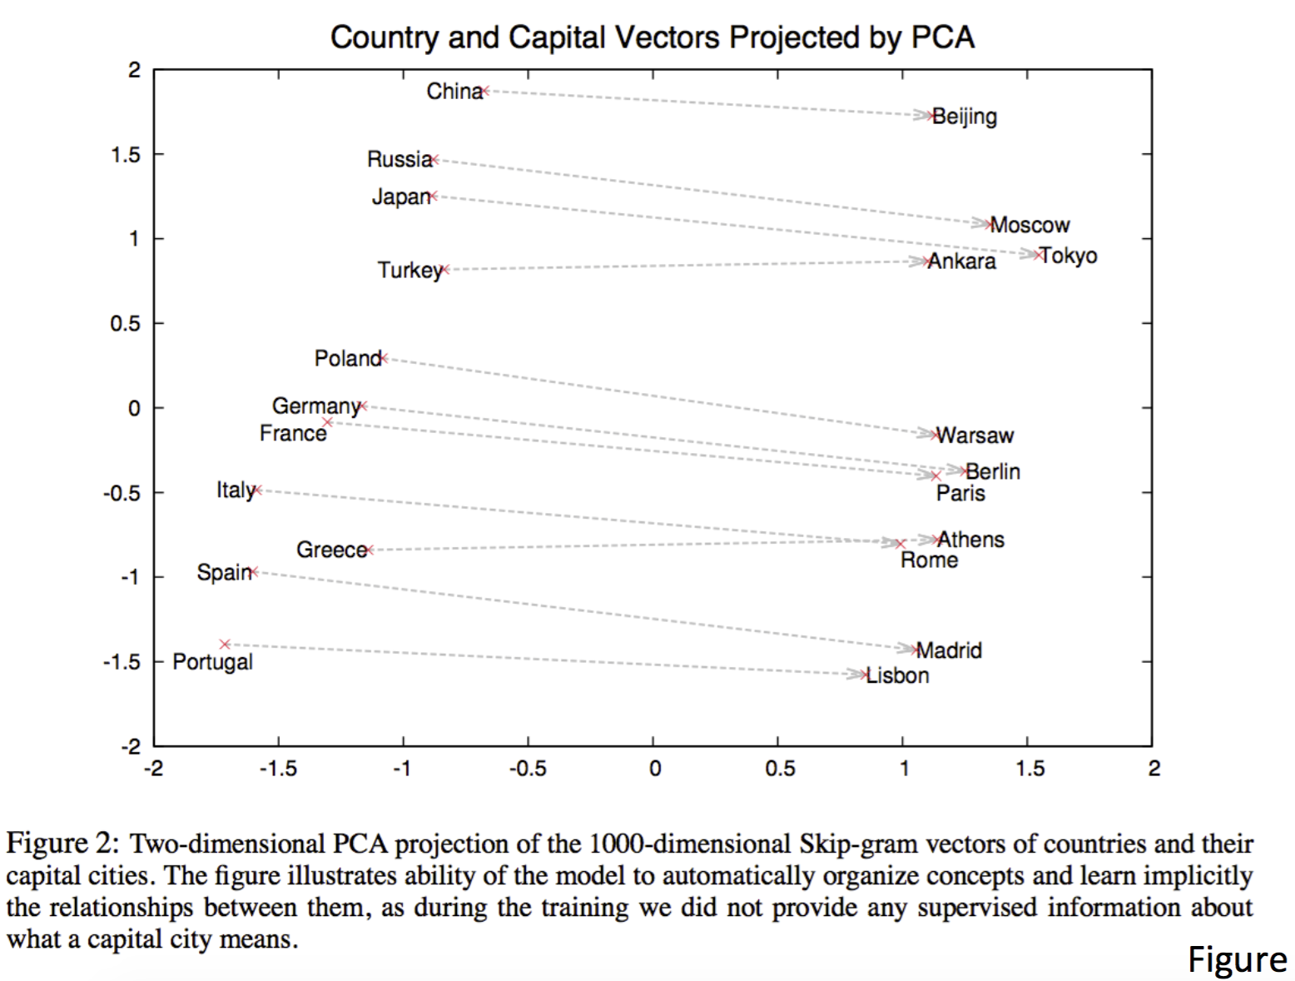
T. Mikolov, I. Sutskever, K. Chen, G. S. Corrado, and J. Dean. Distributed representations of words and phrases and their compositionality. In Advances in Neural Information Processing Systems, pages 3111–3119, 2013.

Slide 58
What can you do with it?
A is to B as C is to ?
It also works for syntactic relations:
vector(biggest) - vector(big) + vector(small) =

Slide 59
What can you do with it?
A is to B as C is to ?
It also works for syntactic relations:
vector(biggest) - vector(big) + vector(small) = vector(smallest)

Slide 60
What can you do with it?
Improve NLP applications:
Sentence completion/text prediction/reply suggestion
Bilingual Word Embeddings for Machine Translation with LSTMs
For this purpose, word2vec has been replaced now with contextual embeddings (transformer-based; BERT, GPT)

Slide 61
What can you do with it?
Improve Text Mining applications:
(Near-)Synonym detection (→ query expansion)
Concept representation of texts
Example: Twitter sentiment classification
Document similarity
Example: cluster news articles per news event

Slide 62
NNs with word embeddings
Neural Networks for text data take word embeddings as low-level representation of words
Word embeddings as input for convolutional neural networks in text categorization
Word embeddings as input for recurrent neural networks in sequence labelling
Since 2018: word embeddings are used as language models that can be fine-tuned towards any natural language processing task (transfer learning, lecture 6)

Slide 63
Conclusions

Slide 64
Homework
Read: Jurafsky & Martin chapter 6. Vector semantics and embeddings (not: 6.7)
Exercise week 3: word2vec tutorial https://www.guru99.com/word-embedding-word2vec.html

Slide 65
After this lecture…
You can explain the principles of topic modelling
You can explain how Latent Dirichlet Allocation (LDA) works on a conceptual level
You can list the advantages and disadvantages of LDA for topic modelling
You can define word embeddings
You can explain how a word2vec model is trained
You can describe 2 applications of word embeddings in text mining tasks
You can train and use a word2vec model yourself

